Slide 1

Powered by python group

Slide 2
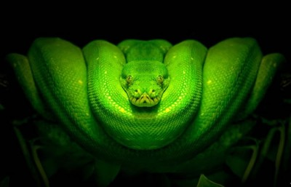


Slide 3
Sesión #2
Printing (Goye)
Data Types
Numbers
int (Sergio)
float (Oscar)
long (Carol)
Strings (Juan)
Lists (Layne)
Dictionaries (Antonio)
Tuples (Christian)
Frozenset (Carlos Arturo)
Boolean (Cesar)
Files (Diego)

Slide 4
Printing
The most basic example of a print statement is:
print 'This is a string'
Strings
You can use the %s to format strings into your print statements.
s = 'STRING' print 'Place another string with a mod and s: %s' %(s)
Multiple Formatting
Pass a tuple to the modulo symbol to place multiple formats in your print statements:
print 'First: %s, Second: %1.2f, Third: %r' %('hi!',3.14,22)
More info: https://pyformat.info/
http://nbviewer.jupyter.org/github/jmportilla/Complete-Python-Bootcamp/blob/master/Print%20Formatting.ipynb/

Slide 5
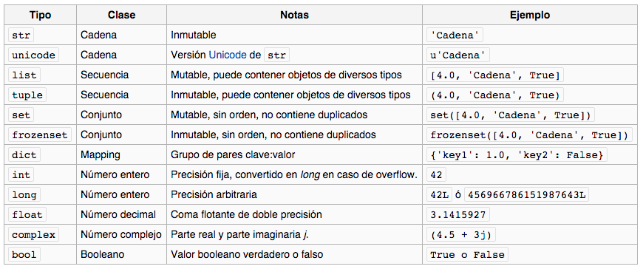
Data Types

Slide 6
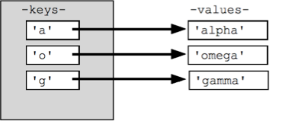
Data Types (Dictionary)
En otros lenguajes son conocidos como “memorias asociativas” o “arreglos asociativos”. Pero al contrario de un arreglo o una lista el índice es una llave.
La mejor forma de entender un diccionario es como un conjunto desordenado de parejas llave - valor.

Slide 7
Data Types (Dictionary)
Métodos de instanciar
dict01 = {'key1': 1, 'key2': 2} dict02 = dict([('key1', 1), ('key1', 2), ('key1', 3)]) dict03 = {x: x**2 for x in (2, 4, 6)}
Equivalencia de instanciación
dict04 = dict(one=1, two=2, three=3)
dict05 = {'one': 1, 'two': 2, 'three': 3}
dict06 = dict(zip(['one', 'two', 'three'], [1, 2, 3]))
dict07 = dict([('two', 2), ('one', 1), ('three', 3)])
dict08 = dict({'three': 3, 'one': 1, 'two': 2})
#true = dict04 == dict05 == dict06 == dict07 == dict08

Slide 8
Data Types (Dictionary)
myDictionary = {'key1': 1, 'key2': 2} myDictionary['key3'] = 3 #agregar elemento myDictionary['key2'] = 4 #actualizar elemento del myDictionary['key1'] #eliminar elemento
for key, val in myDictionary.iteritems(): #iterar diccionario
print key, val

Slide 9
Files
Acceso
f = open('workfile', 'w')
print f
f.write('This is a test\n')
f.close()

Slide 10
¡Gracias!

